Slide 1
ペロブスカイト太陽電池関連論文の発表状況まとめ
2020/07/10
Daily Statistics of (Found) Publications
公開論文数
論文公開日
論文公開日

Slide 2
2019/8/2
2020/1/28
25.2%
25.2%
2019/04
KoreaU
24.2%
KRICT/MIT
plots in NREL chart
(small area cells)
2018/09
KRICT/MIT
23.7%
2018/07
ISCAS
2017/07
23.3%
Nature Photonics 2019, 13,
460-466 2019/4/1 (2018/8/28)
22.7%
ISCAS
2016/03
KRICT
Nature 2019, 567, 511-515
2019/3/27 (2018/6/4)
22.1%
KRICT/UNIST
Science 2017, 356, 1376-1379
2017/6/30 (2017/3/14)
2015/12
EPFL
21.0%
21.6%
2014/11
KRICT
Nature Energy 2016, 1,
16142 2016/9/19 (2016/5/4)
20.9%
ANU
20.1%
KRICT
Science 2015,
348, 1234-1237
2015/5/21 (2015/2/15)
19.7%
KRICT/UNIST
19.6%
EPFL
from efficiency tables
(1cm² cells)
2014/04
KRICT
18.2%
17.9%
NIMS
Nature
2015, 517, 476-480
2015/1/7 (2014/10/20)
2013/12
KRICT
16.2%
Nature Mater.
2014, 13, 897-903
2014/7/6 (2014/2/24)
15.6%
NIMS
EPFL
14.1%
Nature
2013, 499, 316-319
2013/7/10 (2013/4/3)
2013/05

Slide 3
PCE of Perovskite Solar Cells in Published Papers
– marked by device structure –

Slide 4
PCE of Perovskite Solar Cells in Published Papers
UNIST
UNIST
ISCAS
Tianjin-EPFL
UCLA
MIT
UNIST
KRICT
Tianjin
KRICT
KAUST
-Toronto
UCLA
ICCAS
UNSW
Macau
-NTU
Shanghai
ANU
Nanchang
Shandong
ToinU
UNIST-POSTECH
KRICT
HongKongPolytech
UNIST-KookminU
Hangzhou
KRICT
Chengdu
EPFL
EPFL
Nanjing
Wuhan
Beijing
PekingU
Xi’an
Nanjing
Nanjing
Guangzhou
PekingU
EPFL
Jilin
Xi’an
Shanghai
Hangzhou
PekingU
EPFL
Beijing
KAIST
NTU
Xi’an
Tianjin
Beijing
North
Carolina
Xi’an
EPFL
EPFL
UToronto
Xi’an
Shanghai
Turkey
SKKU
KAUST
Shenzhen
EPFL
UToronto
PekingU
PekingU
Beijing
Xiamen
NorthCarolina
Guangzhou
Suzhou
Suzhou
Beijing
Pennsylvania
KoreaU-UNIST
NewSouthWales
NREL
-EPFL
PekingU
NorthCarolina
KRICT
Tianjin
Turkey
UCBerkeley
ISCAS
Beijing
PekingU
Beijing
Jilin
ToinU
Potsdam
EPFL
KyotoU
Suzhou
Princeton
PekingU
Karlsruhe
Shanghai
EPFL
Kaneka
ISCAS
Xi’an
Cambridge
Xi’an
CUHongKong
Shanghai
Chongqing
Cambridge
PekingU
Nebraska
KAUST
KAIST

Slide 5
PCE of Perovskite Solar Cells in Published Papers
– marked by perovskite composition –

Slide 6
PCE of Perovskite Solar Cells in Published Papers
UNIST
UNIST
ISCAS
Tianjin-EPFL
UCLA
MIT
UNIST
KRICT
Tianjin
KRICT
KAUST
-Toronto
UCLA
ICCAS
UNSW
Macau
-NTU
Shanghai
ANU
Nanchang
Shandong
ToinU
UNIST-POSTECH
KRICT
HongKongPolytech
UNIST-KookminU
Hangzhou
KRICT
Chengdu
EPFL
EPFL
Nanjing
Wuhan
Beijing
PekingU
Xi’an
Nanjing
Nanjing
Guangzhou
PekingU
EPFL
Jilin
Xi’an
Shanghai
Hangzhou
PekingU
EPFL
Beijing
KAIST
NTU
Xi’an
Tianjin
Beijing
North
Carolina
Xi’an
EPFL
EPFL
UToronto
Xi’an
Shanghai
Turkey
SKKU
KAUST
Shenzhen
EPFL
UToronto
PekingU
PekingU
Beijing
Xiamen
NorthCarolina
Guangzhou
Suzhou
Suzhou
Beijing
Pennsylvania
KoreaU-UNIST
NewSouthWales
NREL
-EPFL
PekingU
NorthCarolina
KRICT
Tianjin
Turkey
UCBerkeley
ISCAS
Beijing
PekingU
Beijing
Jilin
ToinU
Potsdam
EPFL
KyotoU
Suzhou
Princeton
PekingU
Karlsruhe
Shanghai
EPFL
Kaneka
ISCAS
Xi’an
Cambridge
Xi’an
CUHongKong
Shanghai
Chongqing
Cambridge
PekingU
Nebraska
KAUST
KAIST

Slide 7
PCE of Perovskite Solar Cells in Published Papers
添加物MDACl₂
後処理PEAI
添加物MACl
後処理PEAI
後処理
Theophylline
PEAI
後処理
tBBAI
C8Br
後処理
後処理
後処理
HTL材料
OAI
ETL材料
HTL材料
MeOPEAI
添加物
作製法
後処理
溶媒
添加物
添加物
溶媒
ETL材料
nBAI
ペロ組成
添加物?
添加物
物性
I₂
ETL表面処理
溶液調製手順
後処理
作製法
HTL,ETL材料
ETL材料
後処理
EAI
作製法
後処理
溶媒
物性
残留PbI₂
後処理
タンデム
ETL材料
ETL表面処理
添加物
作製法
ETL材料
添加物
ETL材料
HTL材料
HTL材料
変形2step
ETL材料
後処理
透明
後処理

Slide 8
Voc, Jsc of Perovskite Solar Cells in Published Papers
PCE ≥ 20%
FAPbI₃?
(PCE 24.66%)

Slide 9
Voc, Jsc of Perovskite Solar Cells in Published Papers
PCE ≥ 21%
FAPbI₃?
(PCE 24.66%)

Slide 10
Voc, Jsc of Perovskite Solar Cells in Published Papers
PCE ≥ 22%
FAPbI₃?
(PCE 24.66%)

Slide 11
Voc, Jsc of Perovskite Solar Cells in Published Papers
PCE ≥ 22%
FAPbI₃?
24.66%
2019/11/8
22.3%
24.02%
2020/4/16
2019/6/21
2020/4/21
22.02%
23.7%
23.3%
23.48%
23.5%
2019/12/20
22.6%
22.98%
25.2%
23.31%
22.7%
2020/2/18
2019/11/11
2017/6/30
2019/10/24
23.2%
2019/3/27
2019/4/1
2018/7/9
23.0%
23.3%
23.56%
22.19%
2020/3/8
22.3%
2018/11/23
22.37%
2019/4/15
22.2%
▲
22.39%
2020/5/21
22.7%
2020/2/21
22.5%
2020/5/11
23.4%
22.86%
2020/1/12
1.22 V
24.66 mA/cm²
22.4%
22.51%
2020/5/20
22.2%
22.0%
2020/2/25
2020/3/11
2019/6/14
2019/10/9
2019/6/20
23.24%
2020/5/25
2020/5/13
2020/1/3
22.1%
22.13%
22.0%
2018/8/23
22.2%
23.0%
2020/1/20
22.4%
2019/11/6
2019/12/5
2020/1/23
23.0%
22.16%
24.2%
2019/7/8
22.77%
2019/11/21
2019/12/4
22.6%
22.13%
22.1%
2020/4/1
2020/1/3
22.77%
2020/4/30
22.03%
22.0%
2019/12/18
22.18%
22.02%
2020/4/13
22.04%
2018/7/30
22.0%
2019/8/10
2020/2/20
2019/7/13
22.2%
22.13%
2019/9/23
2020/5/28
2020/1/30
22.0%
2018/9/14

Slide 12
PCE of Perovskite Solar Cells in Published Papers
– marked by preparation method –

Slide 13
Reported Perovskite Solar Modules
in published papers

Slide 14
Reported Perovskite Solar Modules
in published papers, press release, and web release

Slide 15
Reported Perovskite Solar Modules
in published papers, press release, and web release
– comparison of device area –
press, etc.

Slide 16
Reported Perovskite Solar Modules
in published papers
– comparison of device area : colored by device structure –

Slide 17
Reported Perovskite Solar Modules
in published papers
– comparison of substrate area : colored by device structure –

Slide 18
Reported Perovskite Solar Modules
in published papers
– comparison of device area : colored by perovskite materials –

Slide 19
Reported Perovskite Solar Modules
in published papers
– comparison of device area : colored by preparation method –

Slide 20
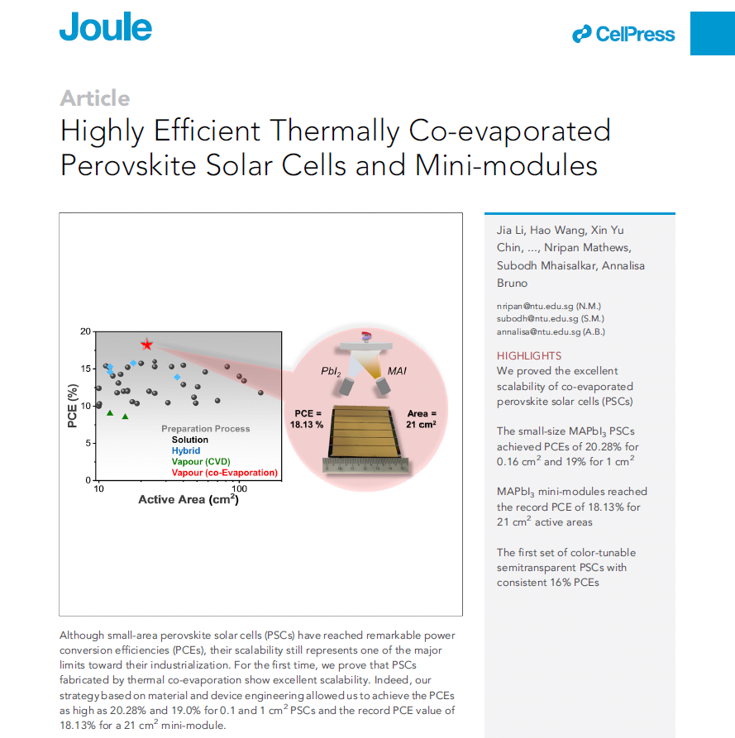
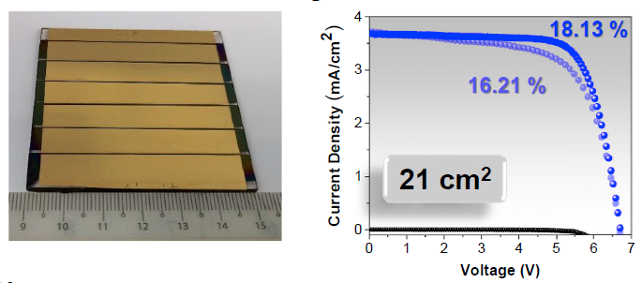
PbI₂ + MAI 共蒸着
→ MAI,KAc/IPA
表面処理
Joule 2020, 4, 1035-1053.

Slide 21
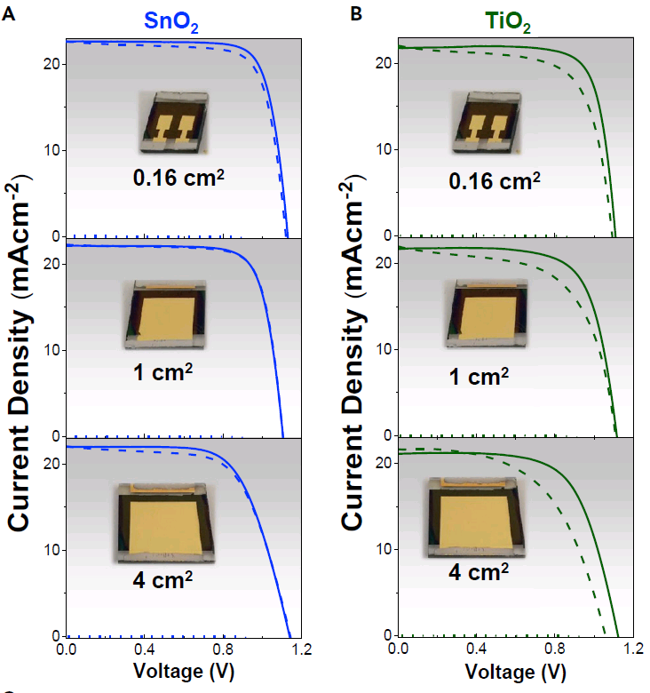
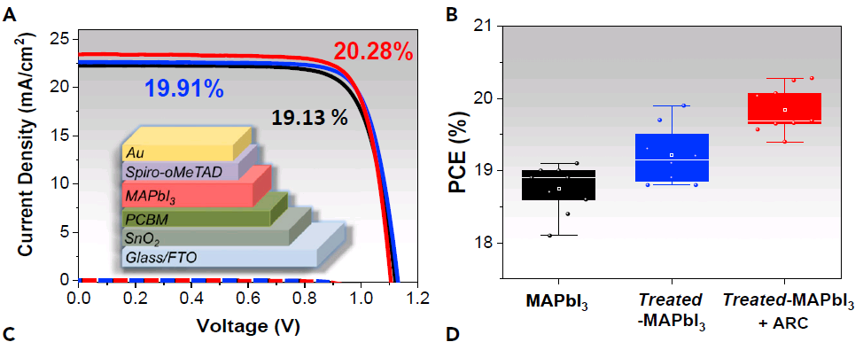
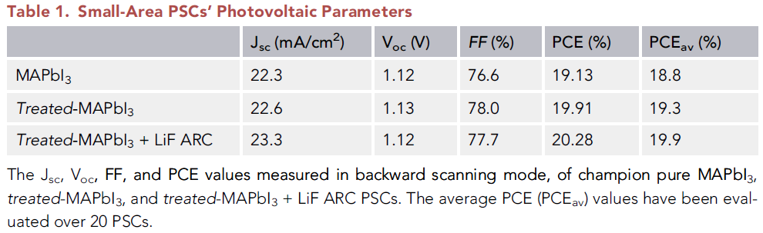
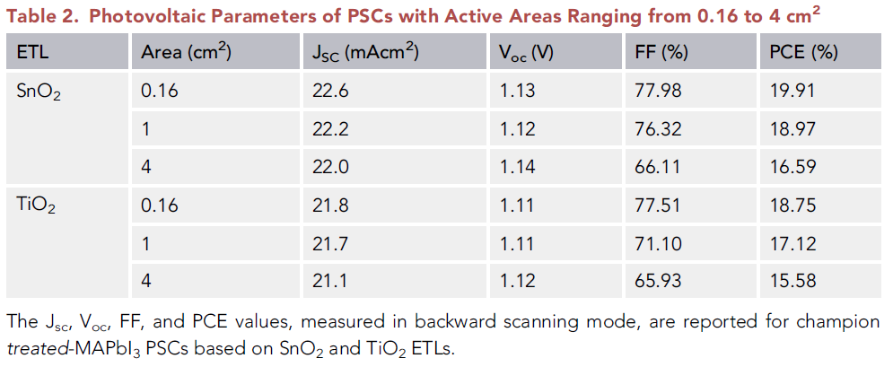
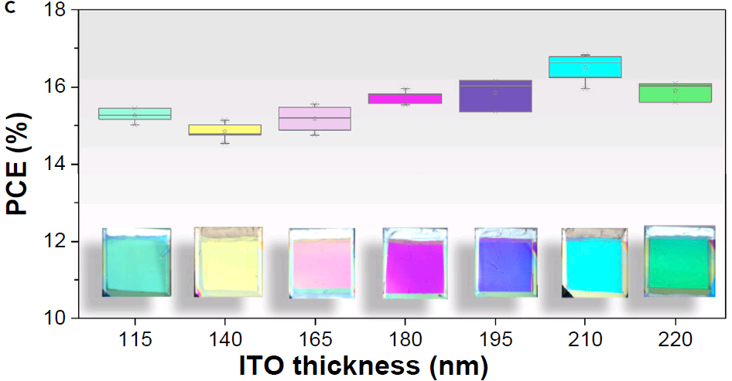
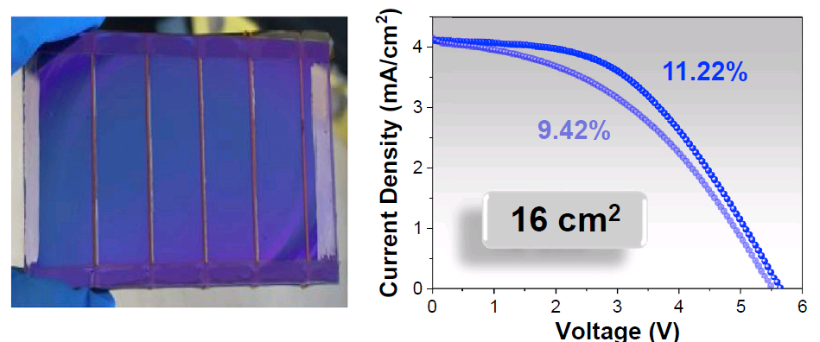
Joule 2020, 4, 1035-1053.
小面積セル
セル
面積拡大
半透明セル・モジュール

Slide 22
Reported Perovskite Solar Modules
in published papers
– comparison of device area : colored by device structure –

Slide 23
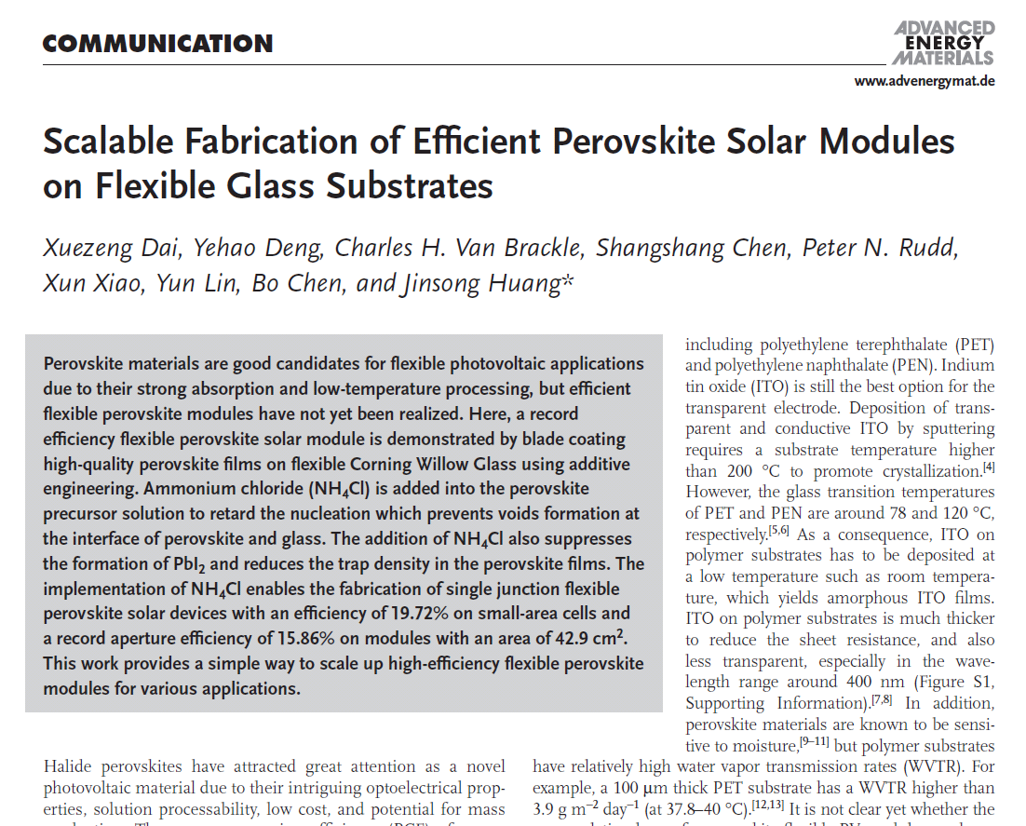
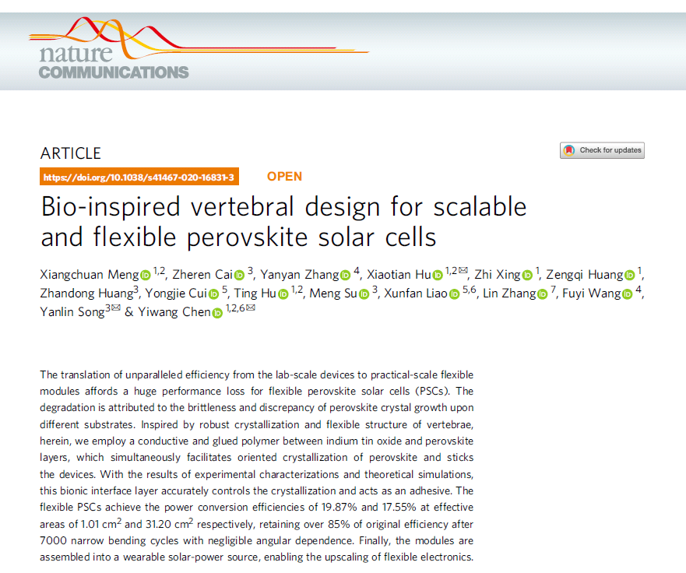
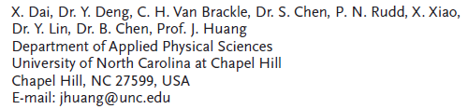
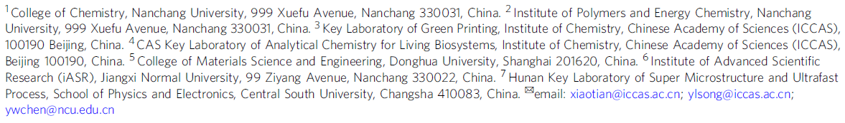
Adv. Energy Mater. 2020, 10, 1903108.
Nature Commun. 2020, 11, 3016.

Slide 24
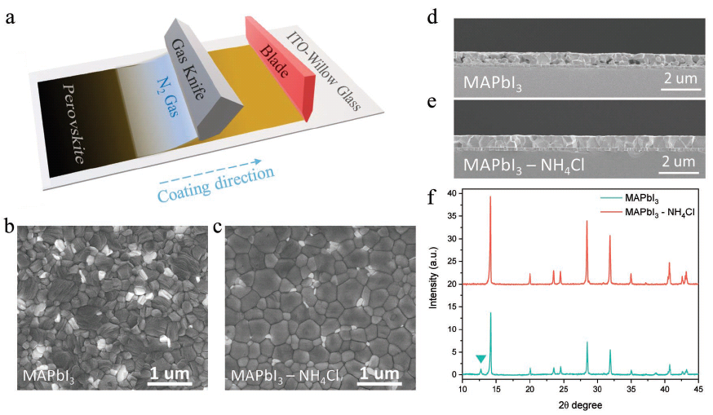
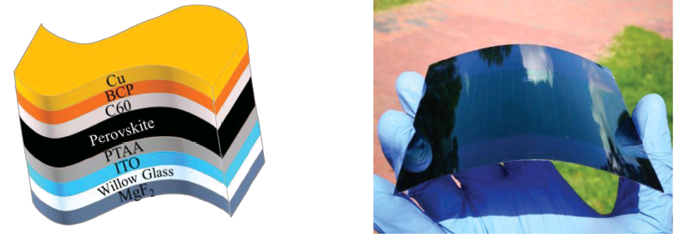
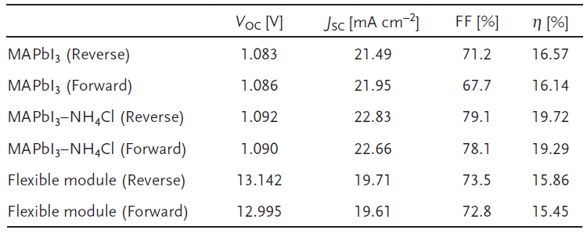
Adv. Energy Mater. 2020, 10, 1903108.

Slide 25
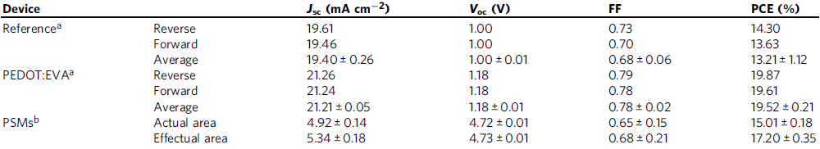
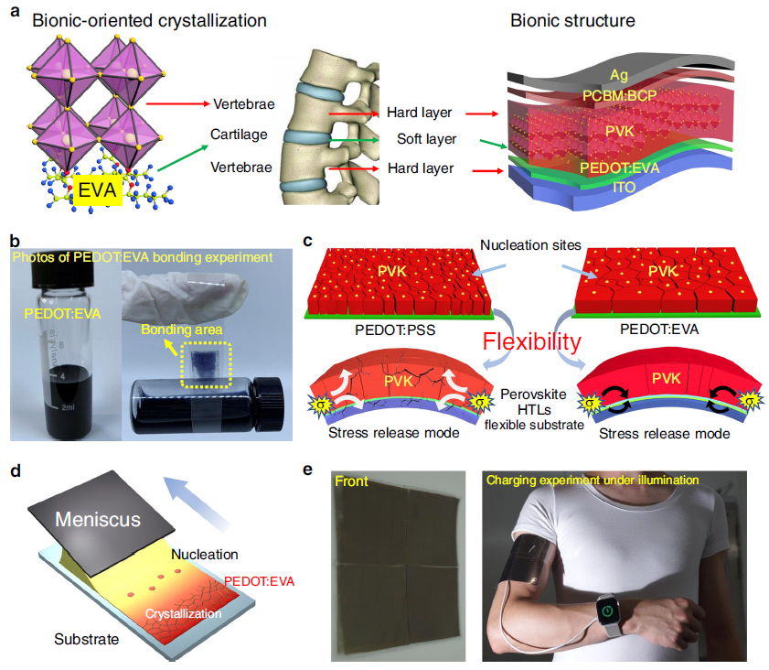
Nature Commun. 2020, 11, 3016.

Slide 26
Perovskite-based Tandem Solar Cells
NorthCarolina
Rome
NREL
Nebraska
Berlin
KAIST
EPFL
EPFL
EPFL
Nanjing
Stanford
CSEM
Toronto
Stanford
NREL
Erlangen
Berlin
SKKU
Tianjin
ANU
UCLA
NREL
NorthCarolina
Ohio
Stanford

Slide 27
Perovskite-based Tandem Solar Cells
Toronto
Kaneka
Erlangen
imec
Dalian
-Xi'an
ANU
ANU
KAUST
NREL
Karlsruhe
EPFL
imec
NTU
Nanjing
Karlsruhe
UNSW
ANU
NREL
SKKU
Empa
Ohio
Chongqing
Toronto
UTokyo
Empa
Karlsruhe

Slide 28
mesoscopic
planar
inverted
light
light
light
TCO glass superstrate
TCO glass superstrate
TCO glass superstrate
ETL
ETL
HTL
HTL
HTL
ETL
TCO
TCO
TCO
Si
Si
Si
mesoscopic（逆入射）
planar（逆入射）
inverted（逆入射）
light
light
light
TCO
TCO
TCO
HTL
ETL
HTL
ETL
HTL
TCO
TCO
TCO
Si
Si
Si

Slide 29
Perovskite-based Tandem Solar Cells
– comparison of device structure of perovskite cell –
top cell (inner)

Slide 30
Perovskite-based Tandem Solar Cells
– comparison of perovskite materials –
top cell (inner)

Slide 31
Perovskite-based Tandem Solar Cells
– comparison of device structure of perovskite cell –
top cell (inner)

Slide 32
Perovskite-based Tandem Solar Cells
– comparison of perovskite materials –
top cell (inner)

Slide 33
Perovskite-Perovskite Tandem Solar Cells
– comparison of device structure –
bottom cell (outer)
top cell (inner)

Slide 34
Perovskite-Perovskite Tandem Solar Cells
– comparison of perovskite materials –
bottom cell (outer)
top cell (inner)

Slide 35
Perovskite-Perovskite Tandem Solar Cells
– comparison of device structure –
bottom cell (outer)
top cell (inner)

Slide 36
Perovskite-Perovskite Tandem Solar Cells
– comparison of perovskite materials –
bottom cell (outer)
top cell (inner)

